Slide 1
Infrastructure as Code Basics Course
INE Cloud Series
An INE On-Demand Course

Slide 2
Topics Covered
What & Why of IaC
Major IaC Providers
Build/deploy basic templates

Slide 3
Skills
Demonstrate IaC
Interpret IaC code
Engineer solutions with IaC

Slide 4
Artifacts
Student Notes
Your notes
Links
Specific notes about the lesson

Slide 5
Thanks for watching
INE Cloud Series
An INE On-Demand Course

Slide 6
Introduction to Infrastructure as Code
INE Cloud Series
An INE On-Demand Course

Slide 7
Topics
What & Why
Advantages
Security

Slide 8
Recipe
5 potatoes
2 eggs
1 cup celery
1 cup onions
¼ tbsp garlic salt
1 cup mayonnaise
Potato Salad

Slide 9
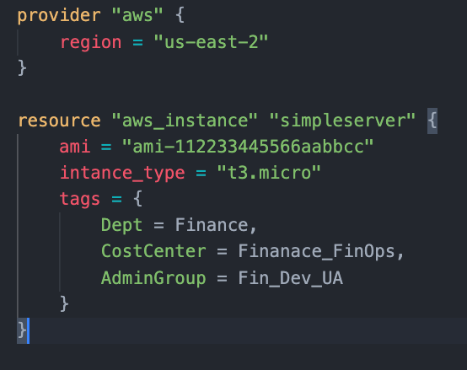
What is Infrastructure as Code

Slide 10


What is Infrastructure as Code
Region
us-east-2

Slide 11





Slide 12
Infrastructure as Code
Region
us-east-2

Slide 13
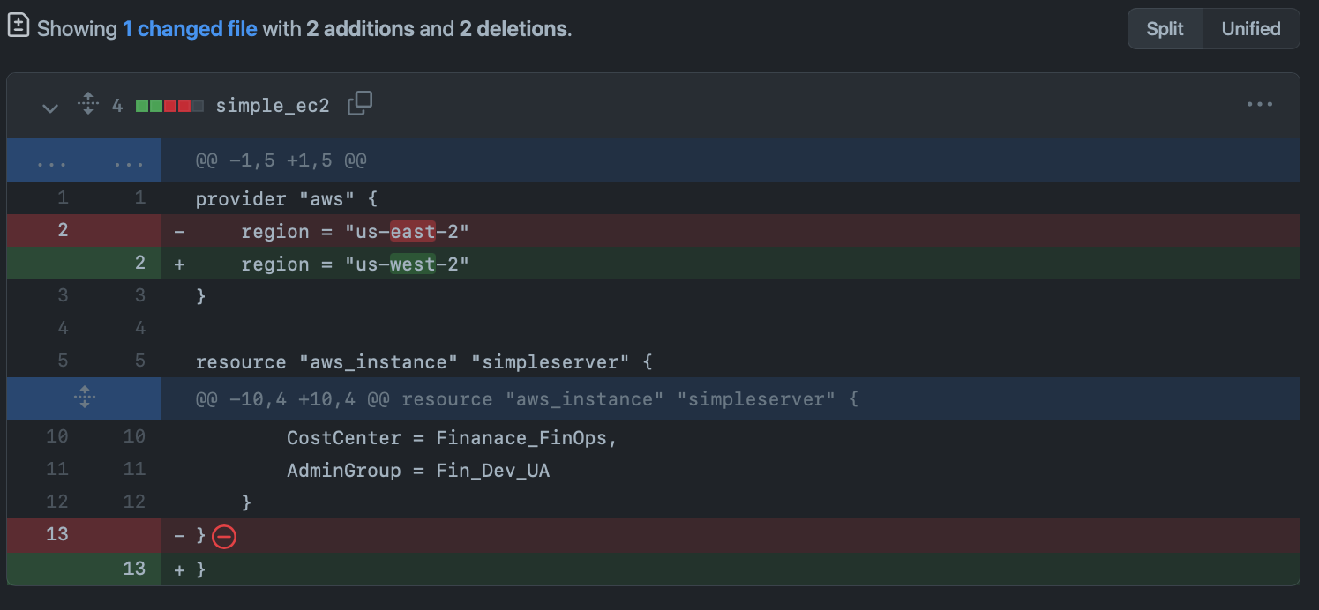
Version Control – Tracking - Collaboration

Slide 14
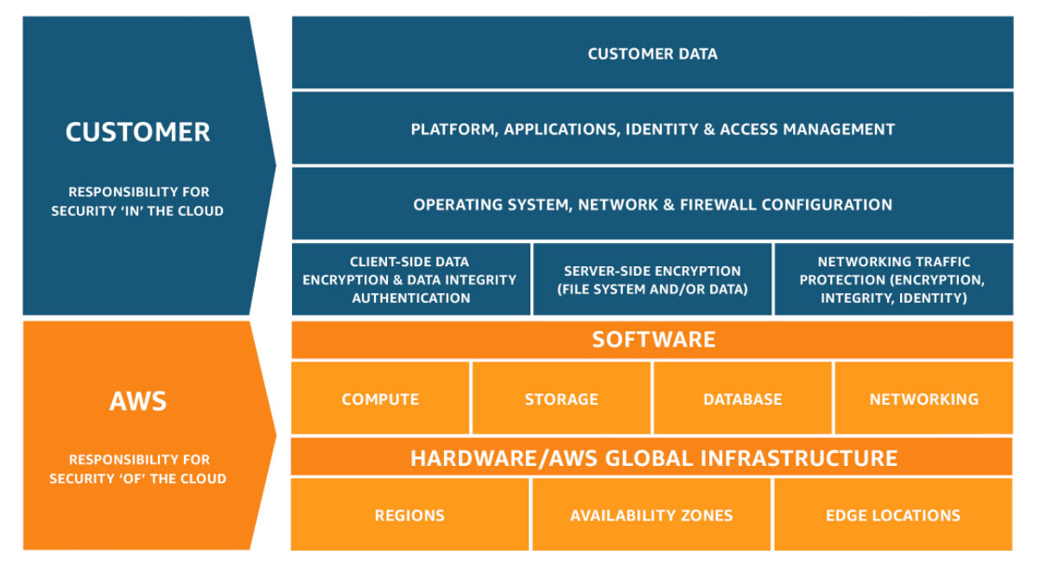
Determine Responsibility
If you can configure it….
…you are responsible for it!!!

Slide 15


Accuracy in Deployments
Template
REGION
REGION
REGION

Slide 16





Disaster Recovery
AWS Cloud
AWS Cloud
Availability Zone 1
Availability Zone 2
Availability Zone 1
Availability Zone 2
VPC
VPC
Amazon EC2 Auto Scaling
NAT gateway
Amazon EC2 Auto Scaling
NAT gateway
NAT gateway
NAT gateway
Auto Scaling group
Auto Scaling group
Instance
Instance
Instance
Instance
Auto Scaling group
Auto Scaling group
Instance
Instance
Instance
Instance

Slide 17
DevOps & CI / CD Integration
Build or Update
Deploy
Test

Slide 18
DevOps & CI / CD Integration
Update
Deploy
Test
Clone & Branch
Pull request

Slide 19
IaC Security
Considerations:
Concrete definition of resources
Storage (GitHub, local VCS)
Who has & controls access

Slide 20
Wrap Up
What & Why
Advantages
Security

Slide 21
Thanks for watching
INE Cloud Series
An INE On-Demand Course

Slide 22
IaC Providers – AWS CloudFormation
INE Cloud Series
An INE On-Demand Course

Slide 23
Topics
AWS CloudFormation
What is AWS CF
Elements
AWS Console

Slide 24

AWS CloudFormation
AWS native infrastructure as code
AWS Console / AWS CLI

Slide 25
AWS CloudFormation - Template
JSON or YAML formatted text file that describes an AWS infrastructure
Template

Slide 26
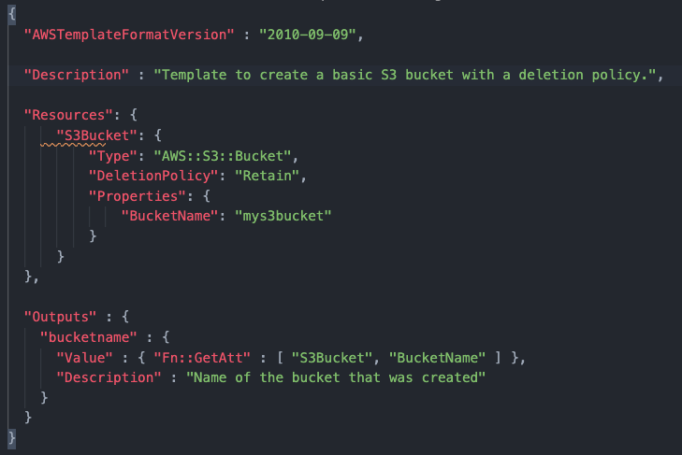
AWS CloudFormation - Template
Template

Slide 27
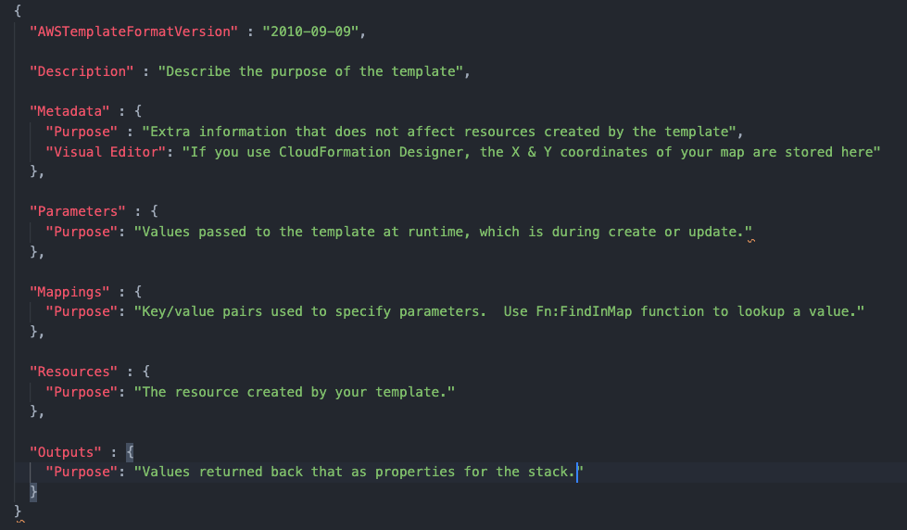
AWS CloudFormation - Template
Template

Slide 28

AWS CloudFormation - Stack
A collection of AWS resources that can be managed as a single unit
Stack

Slide 29
AWS CloudFormation - Demo
Basic elements of the interface
Implementation & Monitoring
Destroy

Slide 30
Wrap Up
What
Elements
Demo

Slide 31
Thanks for watching
INE Cloud Series
An INE On-Demand Course

Slide 32
IaC Providers – AWS CloudFormation Demonstration
INE Cloud Series
An INE On-Demand Course

Slide 33
Thanks for watching
INE Cloud Series
An INE On-Demand Course

Slide 34
IaC Providers – Terraform
INE Cloud Series
An INE On-Demand Course

Slide 35
Topics
Terraform
What is Terraform
Elements
Working with Terraform

Slide 36

Terraform
Created by Hashicorp as a multicloud IaC solution
JSON text files
CLI

Slide 37
Terraform
Installing Terraform is easy
https://learn.hashicorp.com/tutorials/terraform/install-cli

Slide 38
Terraform – Work Flow
Initialize
Plan
Apply
Destroy
Build

Slide 39

Terraform – Work Flow
Initialize
Plan
Apply
Destroy
# terraform init
# terraform plan
# terraform apply
# terraform destroy

Slide 40
Terraform – Work Flow
Initialize
Plan
Apply
Destroy
# terraform init
New directory or a new git, initializes the directory with provider information and dependencies.

Slide 41
Terraform – Work Flow
Initialize
Plan
Apply
Destroy
# terraform fmt
# terraform validate
Protip! Format and validate!

Slide 42
Terraform – Work Flow
Initialize
Plan
Apply
Destroy
# terraform plan
Creates an execution plan of changes
Up to date > Compare > Changes
Careful: Changes between plan and apply

Slide 43
Terraform – Work Flow
Initialize
Plan
Apply
Destroy
# terraform apply
# terraform destroy

Slide 44



Terraform – Work Flow
Initialize
Plan
Apply
Build
# terraform init
# terraform plan
# terraform apply
Notes:
Build

Slide 45
Terraform – Work Flow
Plan
Apply
Build
# terraform plan
# terraform apply
Notes:
Build

Slide 46

Terraform – Work Flow
Apply
Plan
# terraform plan
# terraform apply

Slide 47
Terraform – State Files
Stores state of resources
Used by terraform plan
Directory .terraform
Local or Remote

Slide 48
Terraform – State Files
Amazon S3 state
Amazon DynamoDB lock
One file!

Slide 49
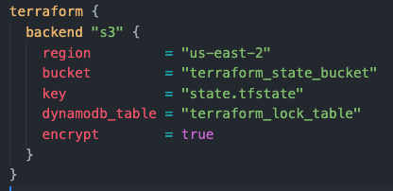
Terraform – State Files

Slide 50
Terraform – State Files
LockID - DynamoDB table partition key name

Slide 51
Wrap Up
What
Elements
Demo

Slide 52
Thanks for watching
INE Cloud Series
An INE On-Demand Course

Slide 53
Terraform: Demo / Lab Walkthrough Introduction
INE Cloud Series
An INE On-Demand Course

Slide 54
Thanks for watching
INE Cloud Series
An INE On-Demand Course

Slide 55
Terraform: Demo / Lab Walkthrough Workstation setup
INE Cloud Series
An INE On-Demand Course

Slide 56
Thanks for watching
INE Cloud Series
An INE On-Demand Course

Slide 57
Terraform: Demo / Lab Walkthrough Fork & Clone GitHub repo
INE Cloud Series
An INE On-Demand Course

Slide 58
Thanks for watching
INE Cloud Series
An INE On-Demand Course

Slide 59
Terraform: Demo / Lab Walkthrough Template Discussion
INE Cloud Series
An INE On-Demand Course

Slide 60
Thanks for watching
INE Cloud Series
An INE On-Demand Course

Slide 61
Terraform: Demo / Lab Walkthrough Configure remote state
INE Cloud Series
An INE On-Demand Course

Slide 62
Thanks for watching
INE Cloud Series
An INE On-Demand Course

Slide 63
Terraform: Demo / Lab Walkthrough Update through applying & Update and apply
INE Cloud Series
An INE On-Demand Course

Slide 64
Thanks for watching
INE Cloud Series
An INE On-Demand Course

Slide 65
Terraform: Demo / Lab Walkthrough Commit changes and cleanup
INE Cloud Series
An INE On-Demand Course

Slide 66
Thanks for watching
INE Cloud Series
An INE On-Demand Course

Slide 67
Terraform: Demo / Lab Walkthrough Bonus: Editing _backend.tf with vim
INE Cloud Series
An INE On-Demand Course

Slide 68
Thanks for watching
INE Cloud Series
An INE On-Demand Course

Slide 69
Infrastructure as Code Conclusion
INE Cloud Series
An INE On-Demand Course

Slide 70
Topics Covered
What & Why of IaC
Major IaC Providers
Build/deploy basic templates

Slide 71
Hands On
AWS CloudFormation
Terraform (including GitHub)

Slide 72
But that’s not all!
Reapply and expand or knowledge of IaC

Slide 73
Thanks for watching
INE Cloud Series
An INE On-Demand Course

